Slide 1




Week-7 (Discussion)
5th Sept, 2025
Computer Vision
Prof. Jayanta Mukhopadhyay
Professor
Computer Science and Engineering Department
IIT Kharagpur
Ayan Paul
PMRF Research Scholar
IIT Kharagpur

Slide 2
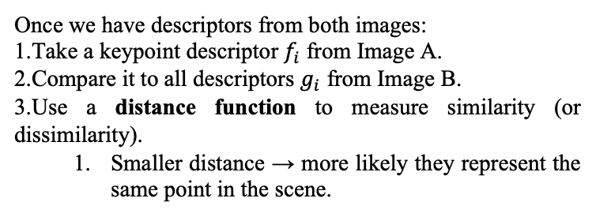
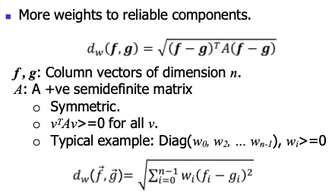
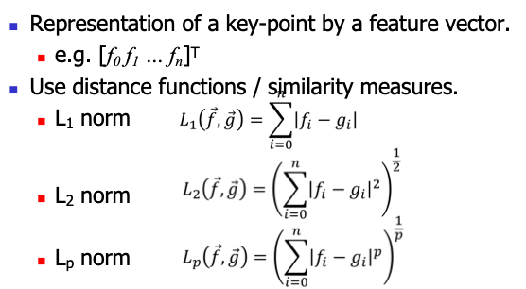
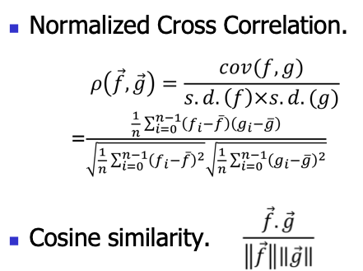
Matching key points
Weighted Distance function
Distance functions
A few other similarity measures

Slide 3
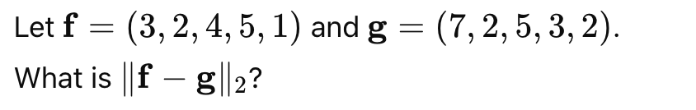
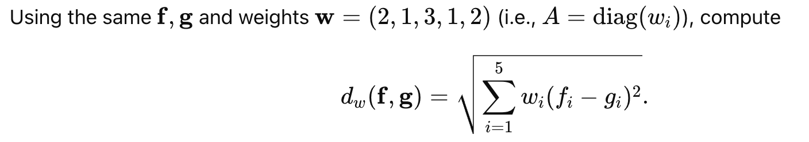
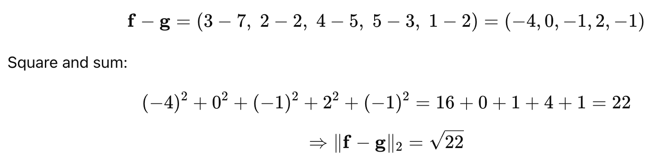
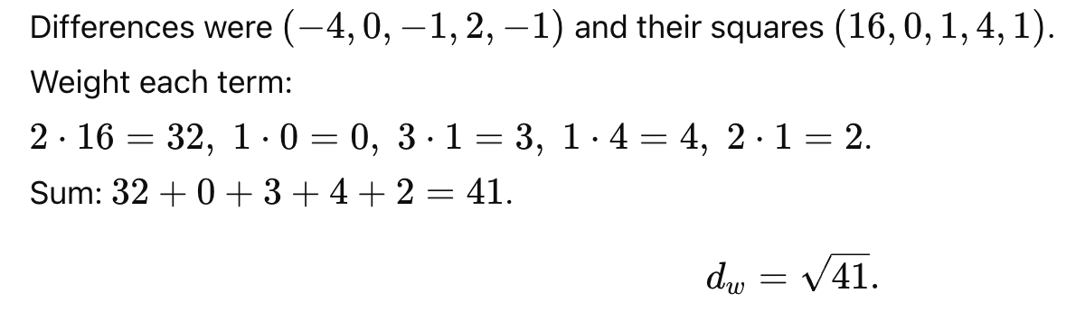
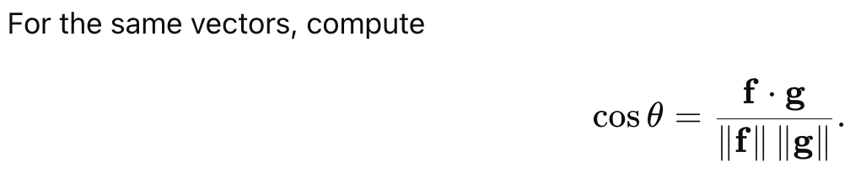
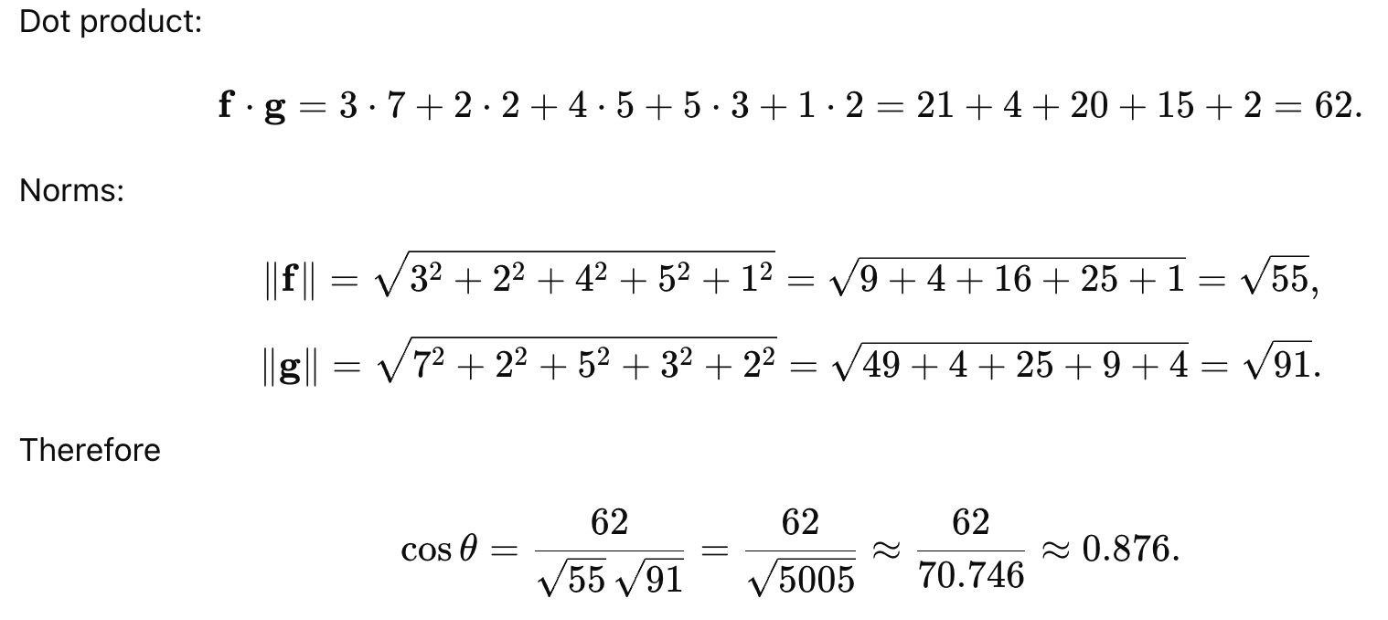
Exercise - 1
Exercise - 2
Solution
Solution
Exercise - 3
Solution

Slide 4
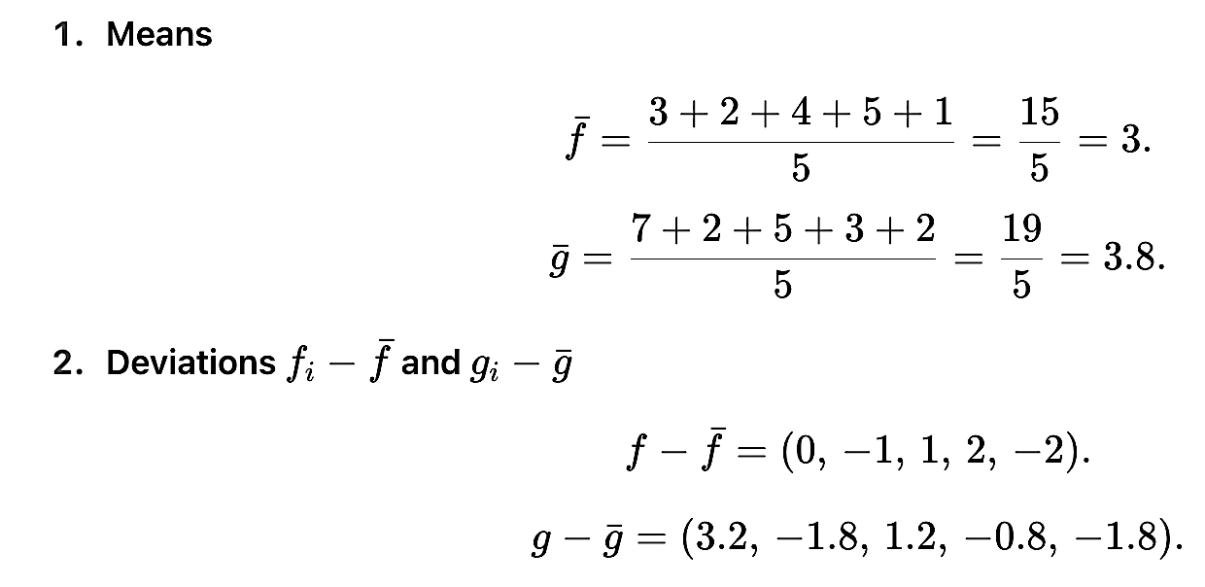
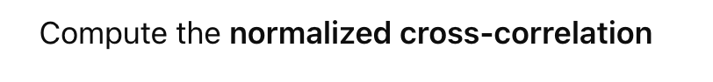
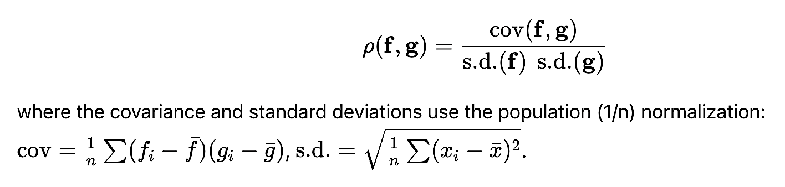
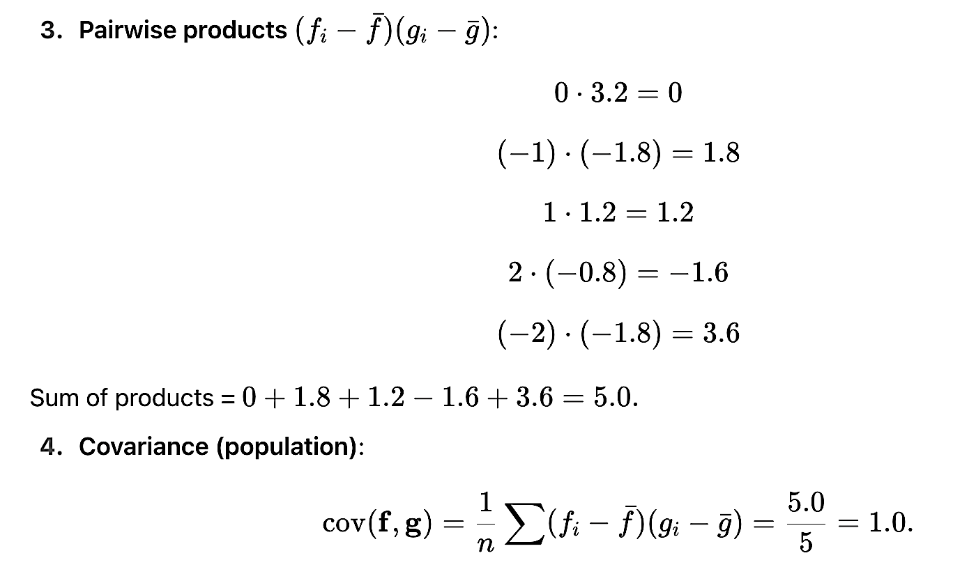
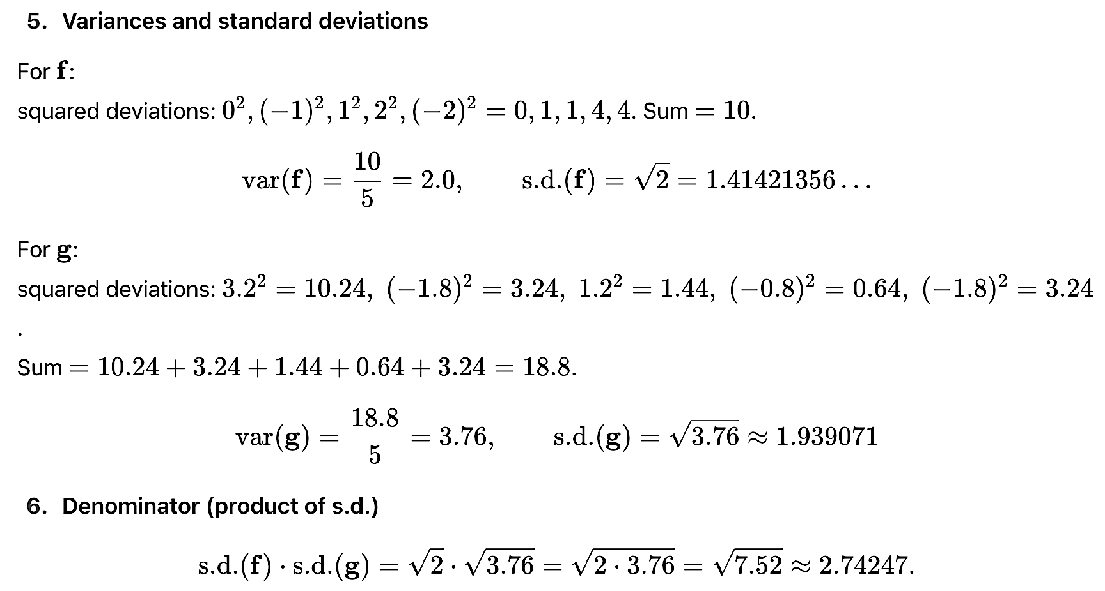
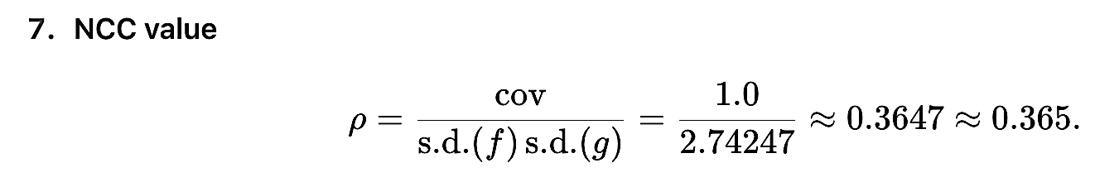
Exercise - 4
Solution

Slide 5
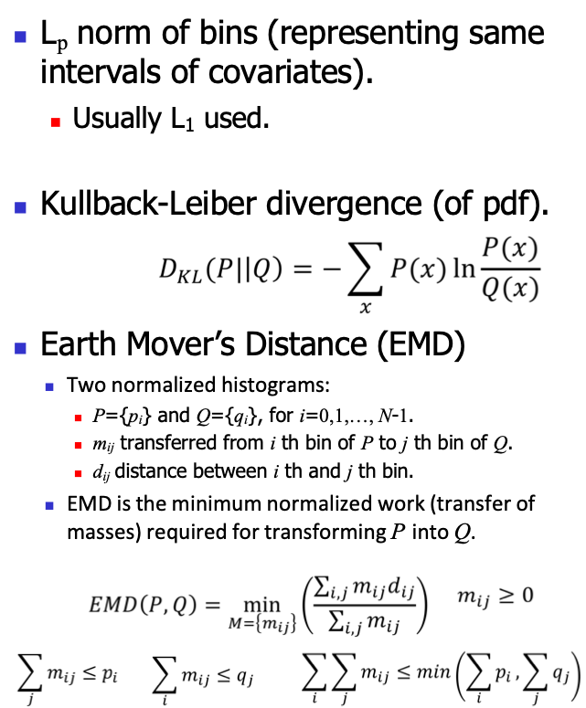
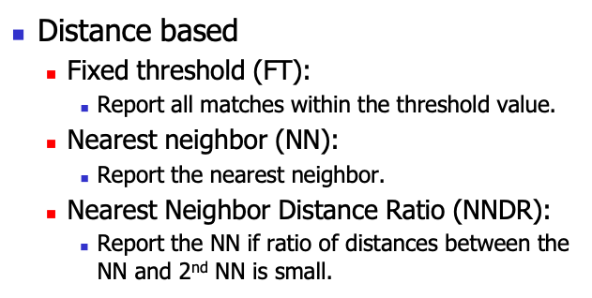
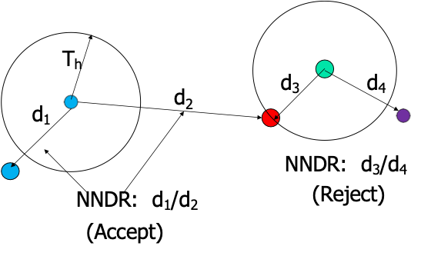
Matching criteria
Matching histograms

Slide 6
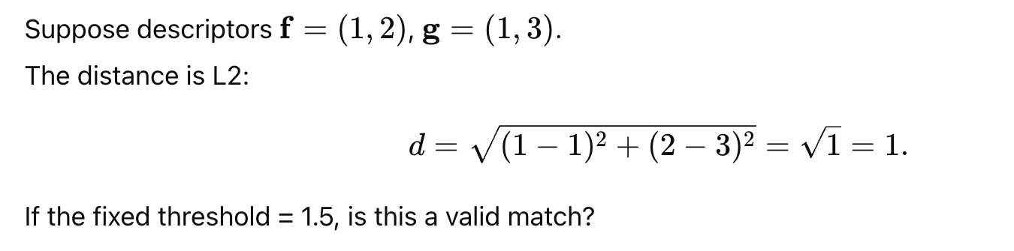
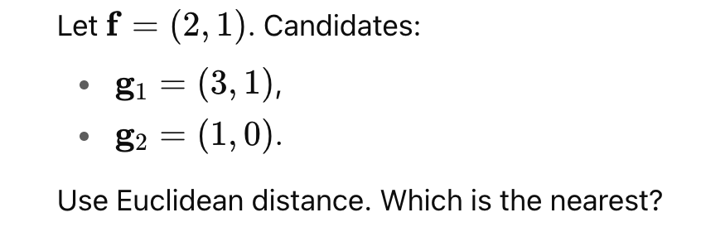

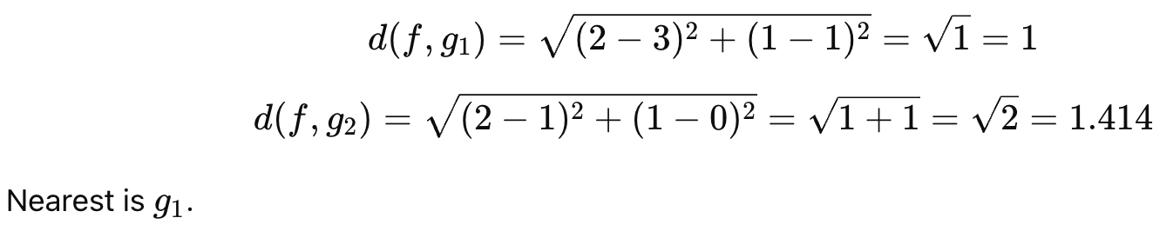
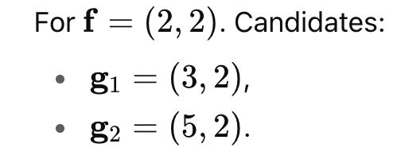

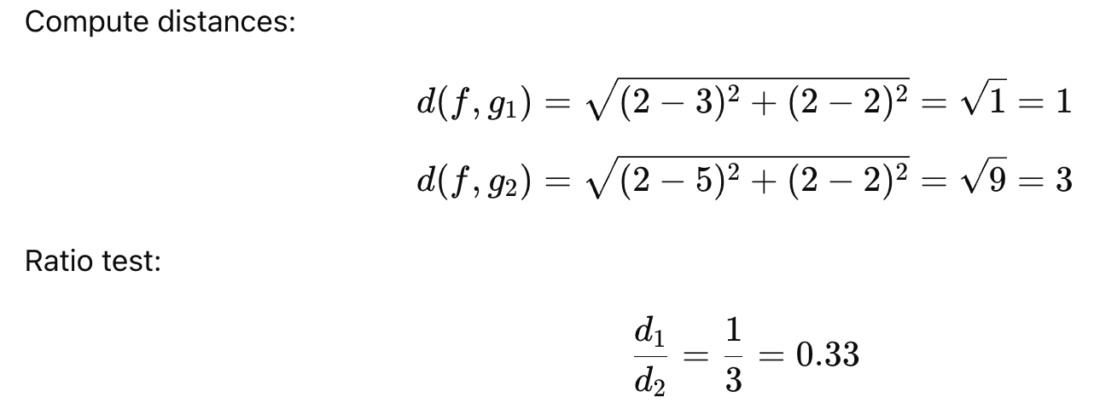
Exercise - 5
Exercise - 6
Solution
Solution
Exercise - 7
Solution

Slide 7
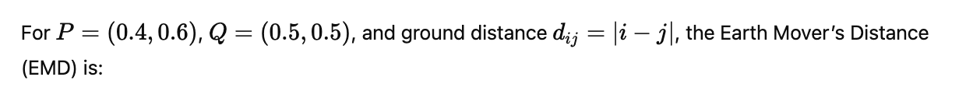
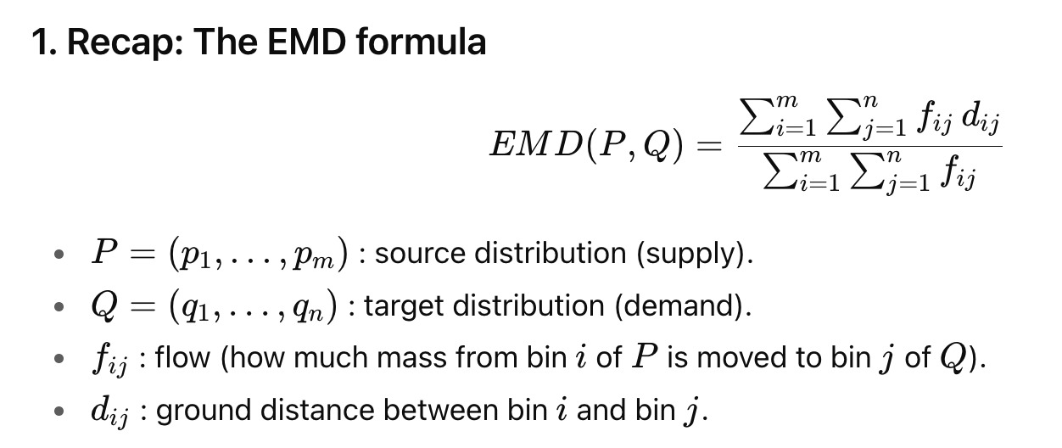
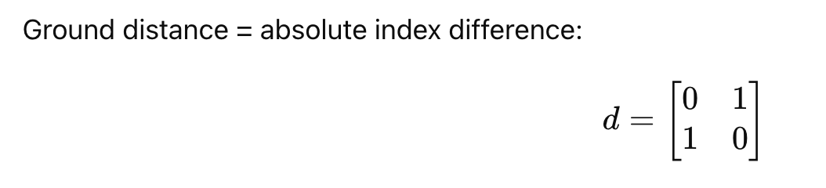
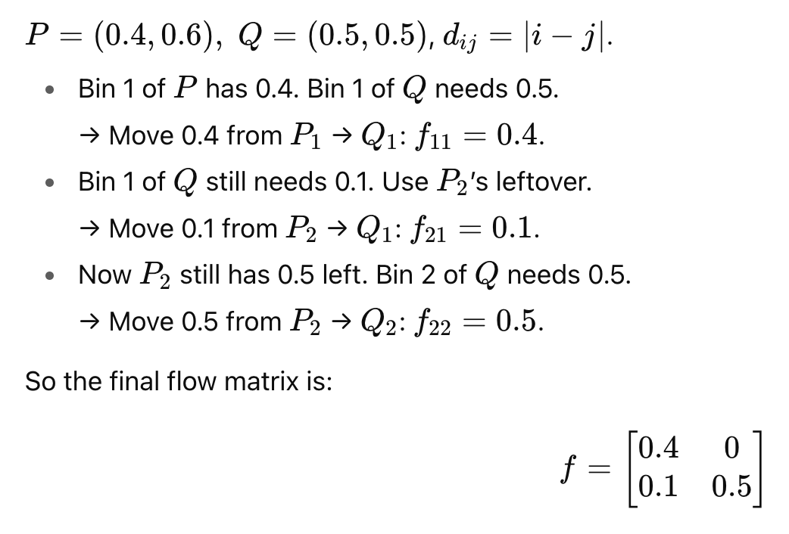
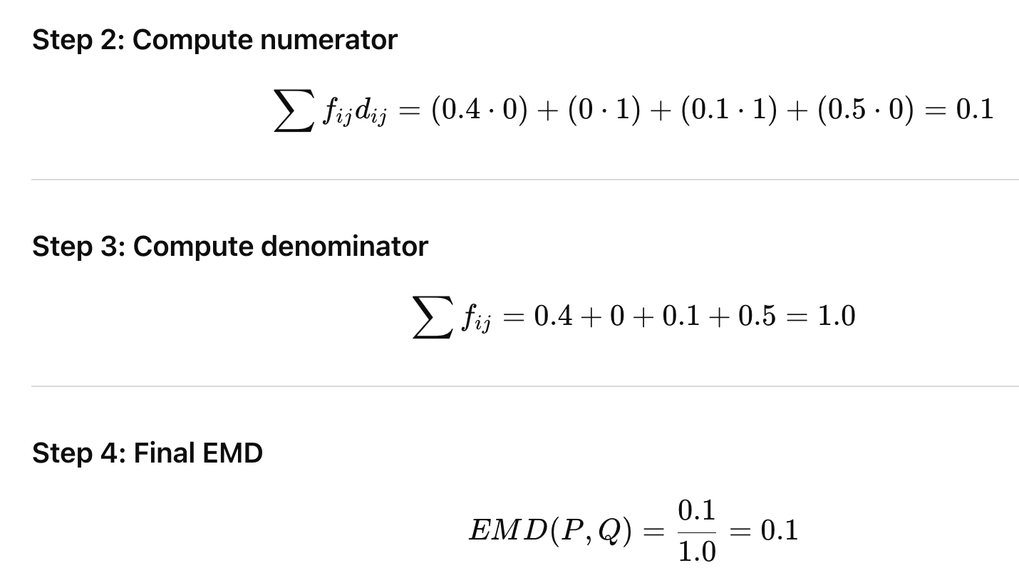
Exercise - 8
Solution

Slide 8
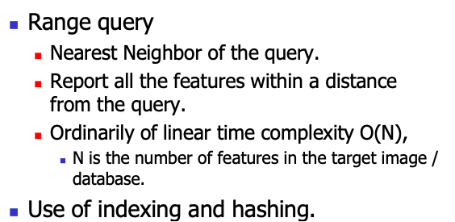
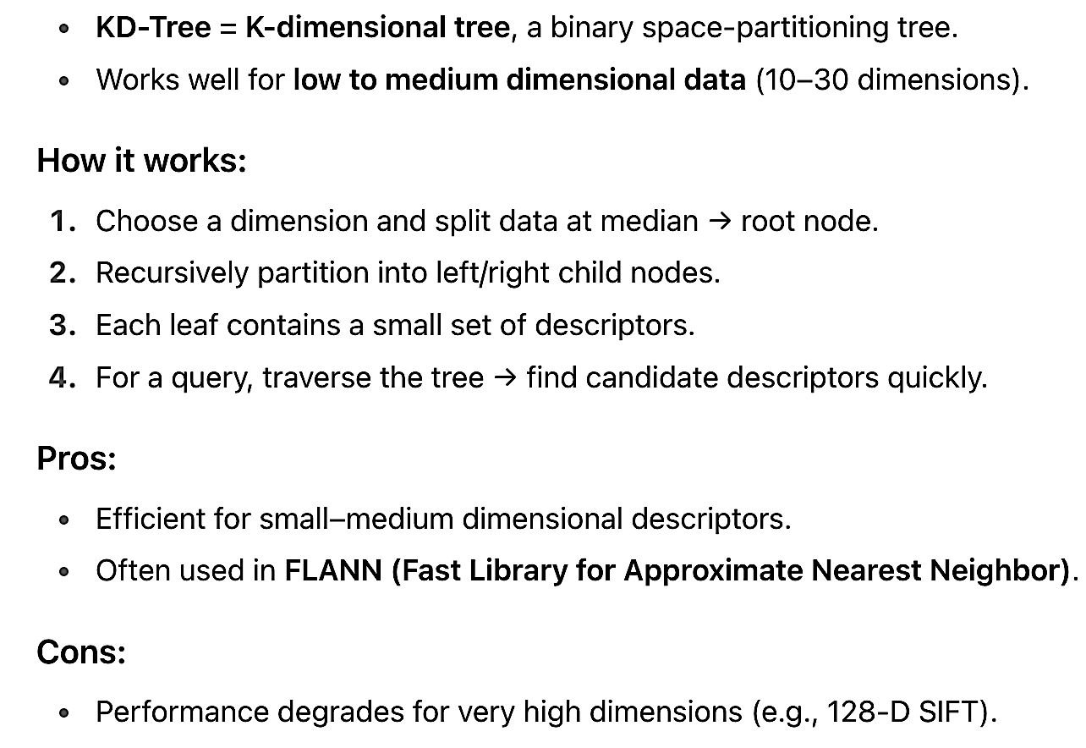
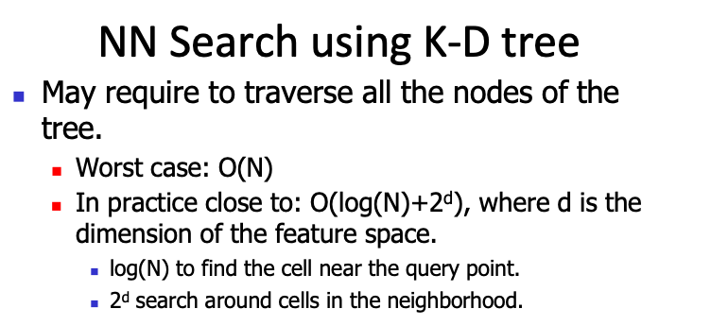
Efficient computation of feature matching
Why Indexing/Hashing?
When matching features:
Each image can have thousands of descriptors.
Brute force search = compare every descriptor in Image A to all descriptors in Image B → very slow for large datasets.
Indexing and hashing make nearest-neighbor search much faster.
K-D tree

Slide 9
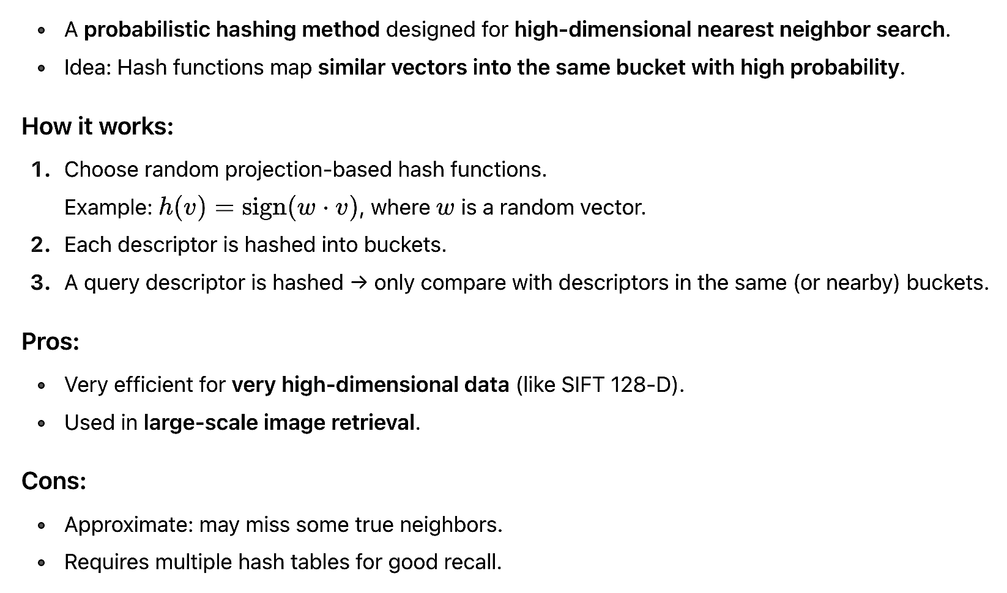
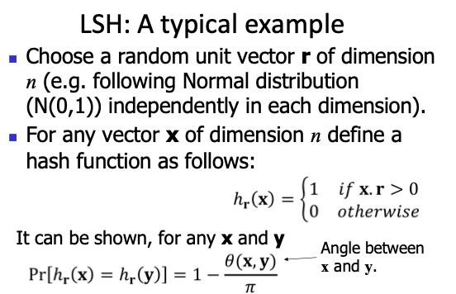

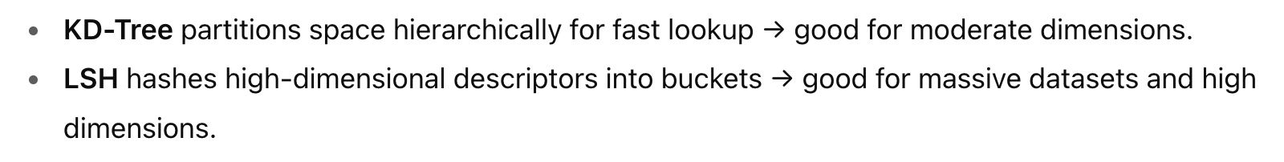
Locality sensitive hashing (LSH)

Slide 10
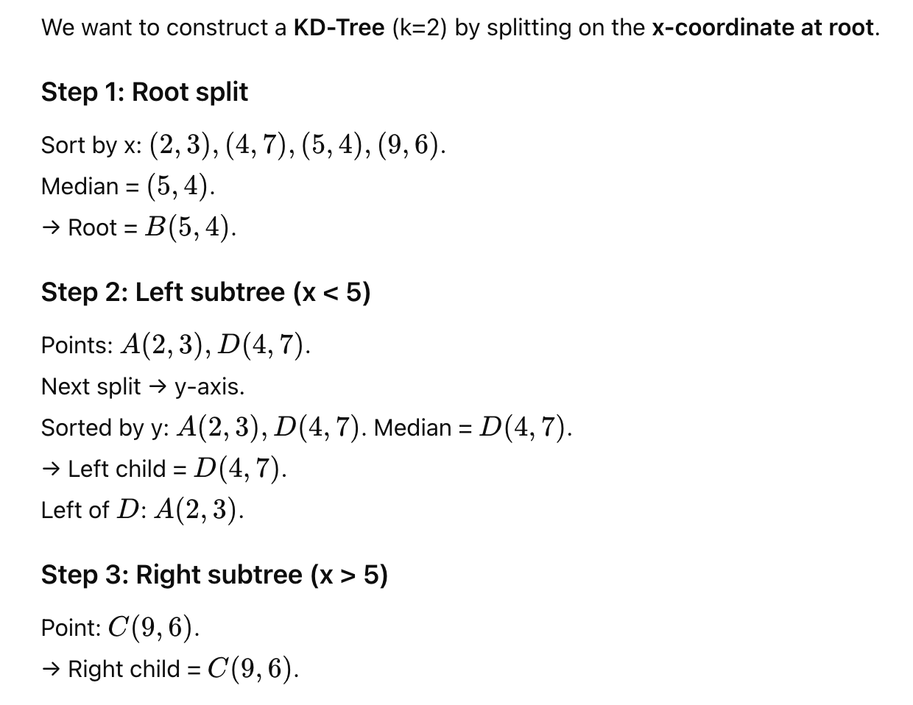
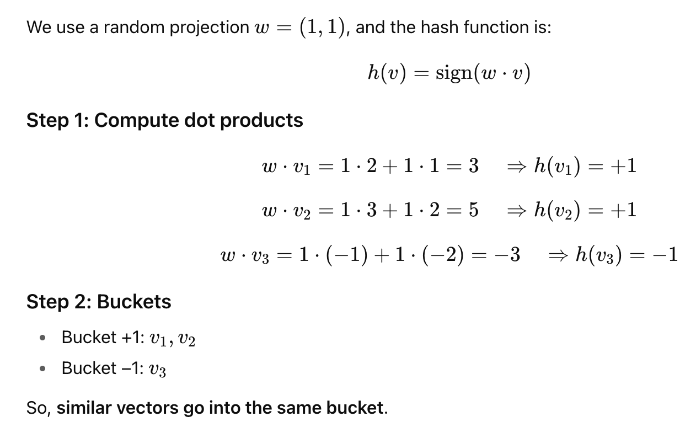
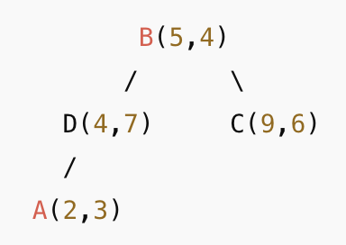
Exercise - 9
Solution
Exercise - 10
Solution

Slide 11
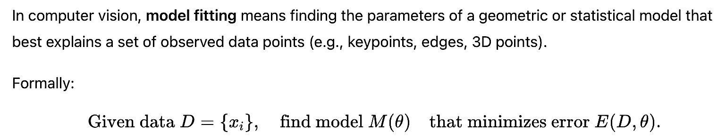
Model fitting
Given a set of data points fit a model to establish relationship among the data points.
Homography matrix between pixels in two images of the same planar scene.
Fundamental matrix between corresponding points in two stereo images.
Given a set of 2-D points fit a straight line / parabolic curve / circle / a high degree polynomial curve passing through them.
Obtain data points and fit appropriate model.
Preprocessing, feature detection-description-matching.
Choice of a model
Error of fitting
Mean square error
Likelihood
Pr (Data | Model)
Size of a model
Number of independent parameters
Training and Test Error
Large training error: Under-fitting.
Low training error, but large test error: Over-fitting
Low training and test error: A good fit.

Slide 12
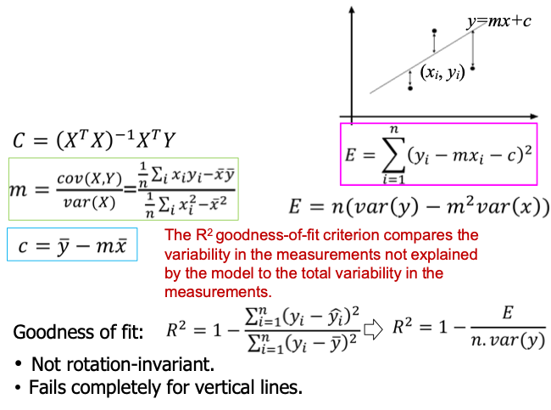
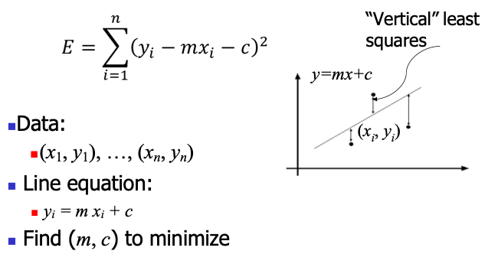
Fitting a straight line over 2D points
Line fitting in varying contexts
Fitting techniques
Least Squares
Total Least Squares
Random Sample Consensus (RANSAC)
Hough Voting
Given points belonging to a line, to find the “optimal” line parameters.
Least squares
To handle outliers.
RANSAC
Presence of many lines.
Voting methods: Hough transform
Least squares line fitting

Slide 13
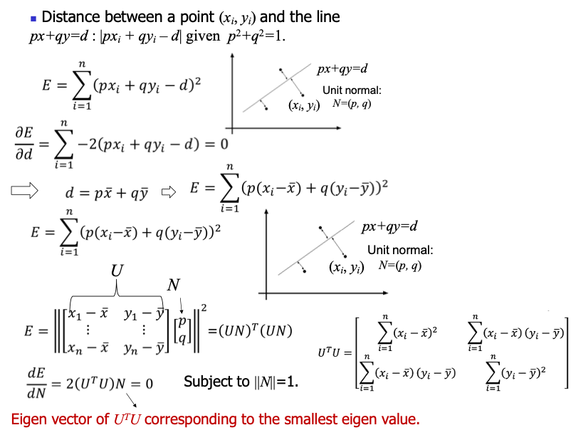
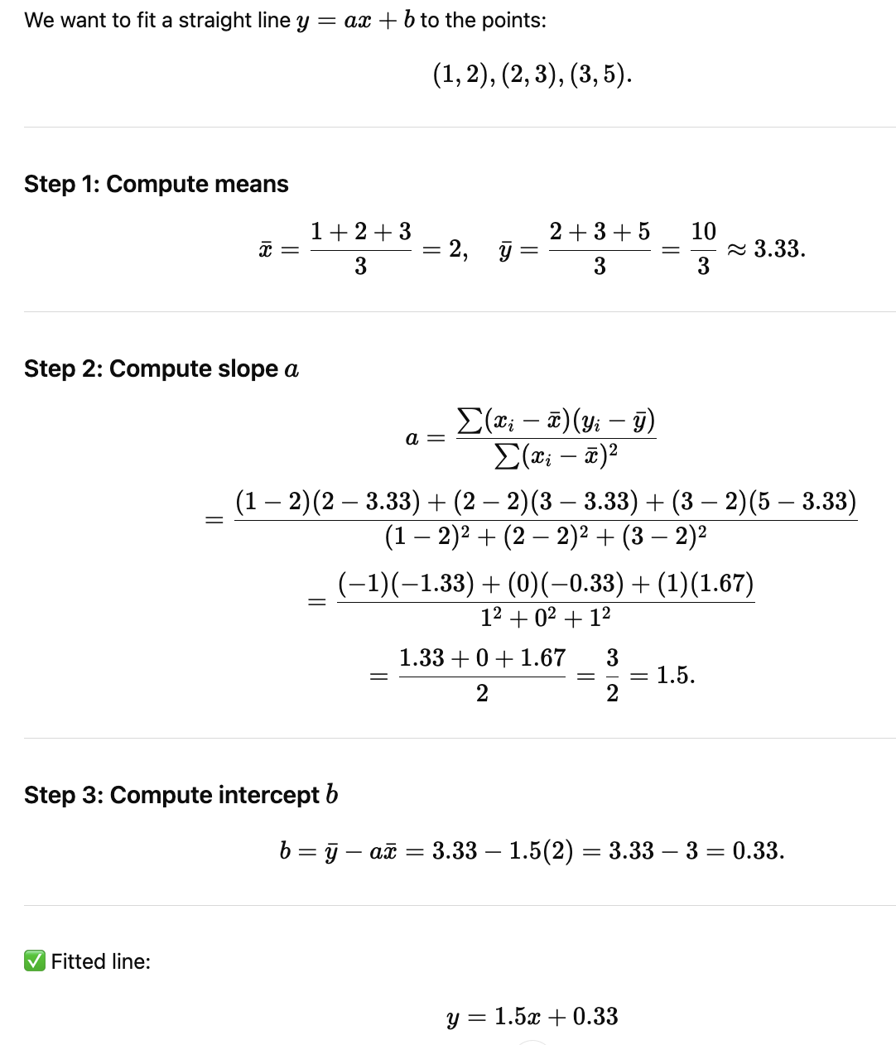
Total least squares
Exercise - 11
Solution

Slide 14
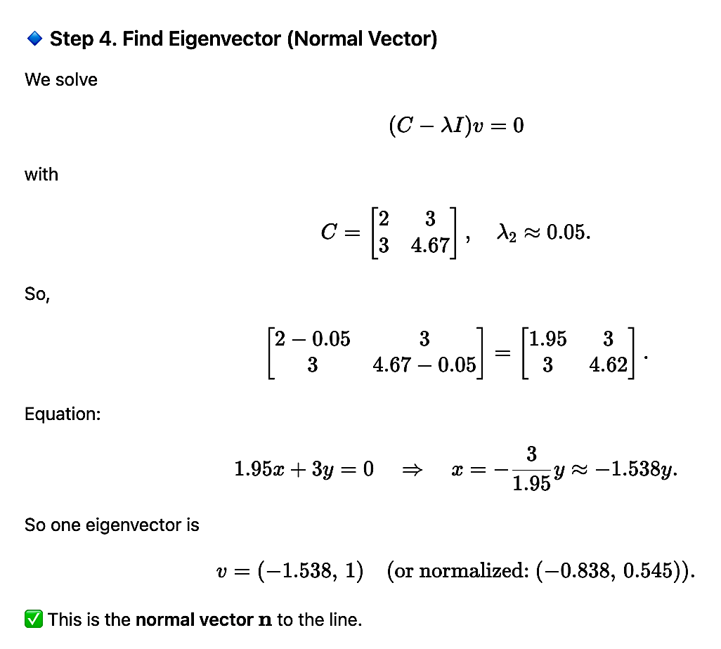
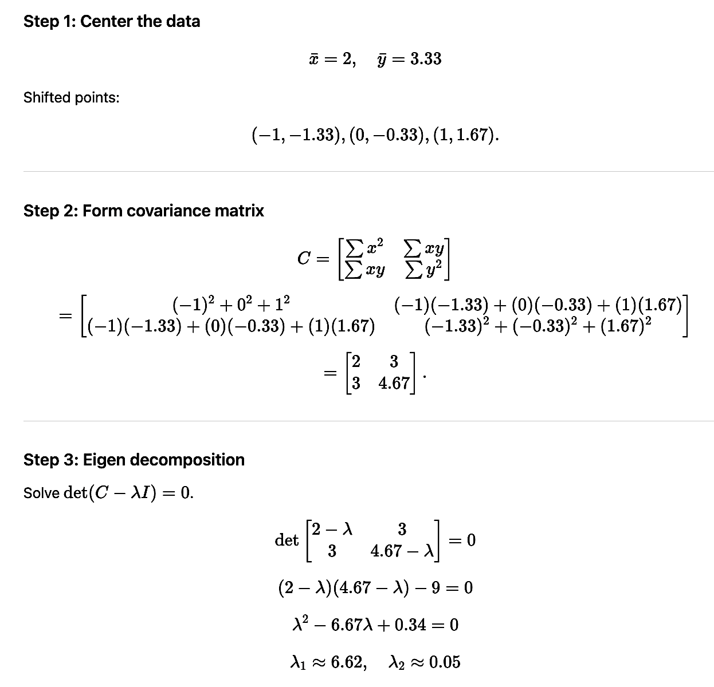
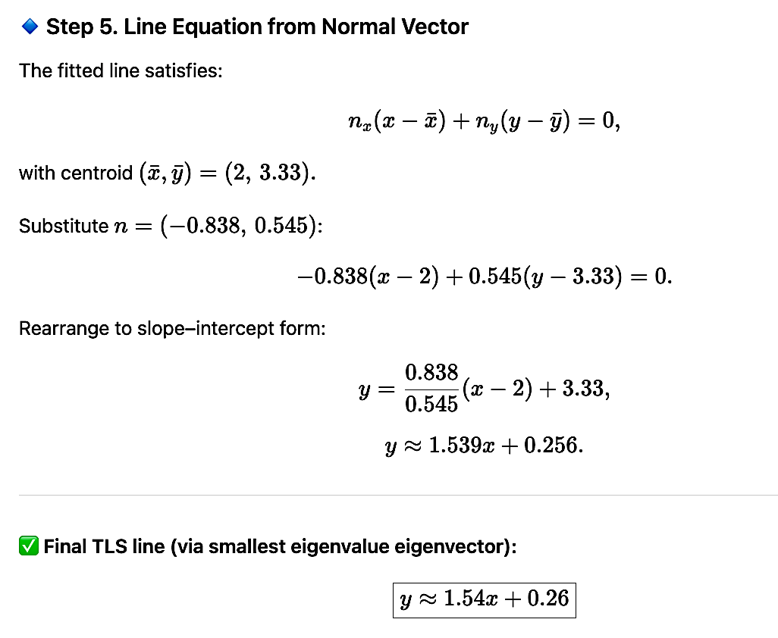
Exercise - 12
Solution

Slide 15
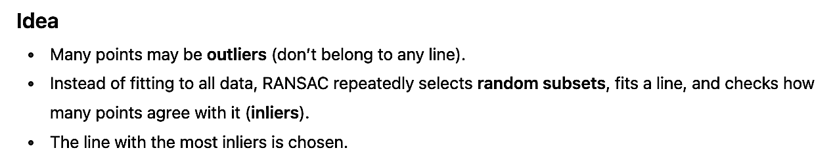
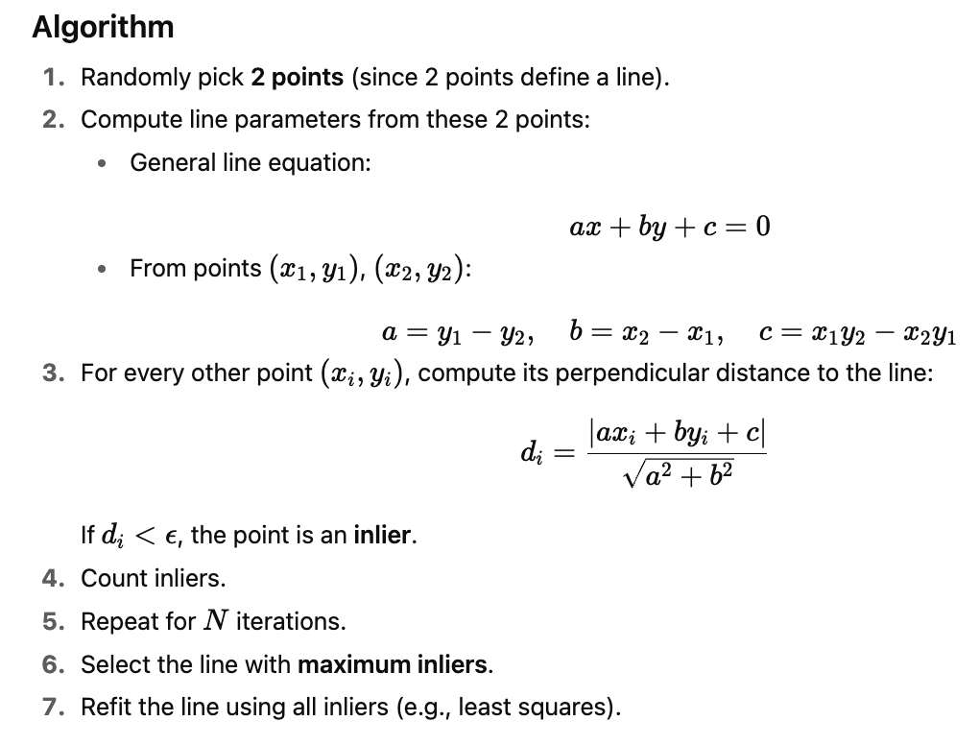
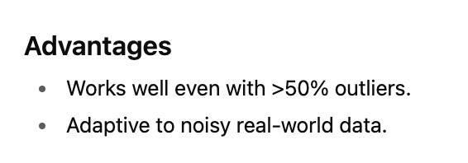
Random sample consensus (RANSAC)

Slide 16
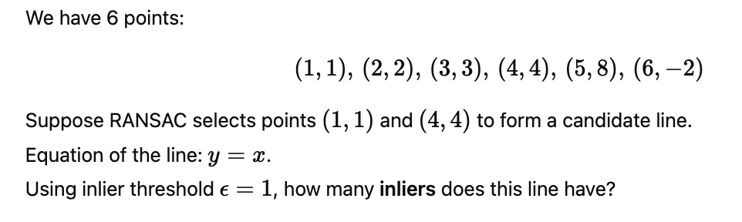

Exercise - 13
Solution

Slide 17




Hough transform

Slide 18


Exercise - 14
Solution

Slide 19



Dealing with noise

Slide 20

Comparison of Line Fitting Methods

Slide 21
Topics on which Week 7 Assignment Questions are based
Key point matching – distance and similarity functions
Matching criteria – distance-based and matching histograms
Efficient computation of feature matching – range query, indexing (K-D tree) and hashing (LSH)
Straight line Model fitting – Least squares, Total least squares, RANSAC, Hough voting

Slide 22



QUESTION 1
Given two features each of size 4 as f = [4, 1, 2, 4] and g = [9, 1, 2, 2]. Compute normalized cross correlation and cosine similarity, respectively.
a) 7 and 5.38
b) 0.632 and 0.849
c) 2 and 4.38
d) 8 and 4.38
SOLUTION 1
CORRECT ANSWER 1
b)

Slide 23



QUESTION 2
Let d1 (10), d2 (8) be the distances to the nearest and the next nearest neighbors from a query feature, respectively for a threshold limit of 0.6. Choose the correct option:
a) Nearest neighbor distance ratio d1/d2 accepts nearest neighbor as a match
b) Nearest neighbor distance ratio d1/d2 rejects nearest neighbor as a match
c) Both a and b
d) None of the above
SOLUTION 2
CORRECT ANSWER 2
b)

Slide 24


QUESTION 3
Find KL distance between A and B with probability distribution (0.2, 0.4, 0.15, 0.1, 0.05) and (0.3, 0.35, 0.05, 0.2, 0.15) respectively.
a) 0.0129
b) −0.158
c) −0.084
d) None of the above
SOLUTION 3
CORRECT ANSWER 3
a)

Slide 25

QUESTION 4
RANSAC is best suited to find the ‘optimal’ line parameters when points belonging to a line
are given.
a) True
b) False
SOLUTION 4
CORRECT ANSWER 4
False

Slide 26

QUESTION 5
Which of the following methods is best suited for line fitting with outliers.
a) Least squares
b) RANSAC
c) Hough transform
d) Kullback-Leiber Divergence
SOLUTION 5
CORRECT ANSWER 5
b)

Slide 27

QUESTION 6
Low training error necessarily indicates overfitting.
a) True
b) False
SOLUTION 6
CORRECT ANSWER 6
False

Slide 28

QUESTION 7
Consider two points a = (1, 3) and b = (3, 5) in image space, compute two lines
corresponding to them in parameter space.
a) c = -m + 2 and c = -3m + 4
b) c = -m + 2 and c = -3m + 2
c) c = -m + 3 and c = -3m + 5
d) c = -m + 1 and c = -3m + 1
SOLUTION 7
CORRECT ANSWER 7
c)

Slide 29



QUESTION 8
Calculate cosine similarity between [3, 2, 8, 2, 5] and [4, 2, 8, 9, 4].
a) 0.584
b) 0.851
c) 0.807
d) None of the above
SOLUTION 8
CORRECT ANSWER 8
b)

Slide 30

QUESTION 9
Choose the correct options:
a) Hough transform requires appropriate resolution of discretization of the grid in parameter space
b) If grids are too coarse, too many different points in image space map to single bucket
c) If grids are too fine, some points may not be exactly collinear voting different buckets
d) Hough transform does not require any discretization of the grid in parameter space
SOLUTION 9
.
CORRECT ANSWER 9
a), b), c)

Slide 31




QUESTION 10
Using the method of least squares, find an equation of the form y = ax + b that fits the data given as (x, y) coordinates. [(0, 1), (1, 5), (2, 10), (3, 11), (4, 13)]
a) y = 8x − 8
b) y = 3x + 12
c) y = 3x + 2
d) y = 3x − 2
SOLUTION 10
CORRECT ANSWER 10
c)

